Slide 1
SET Operations

Slide 2
Outline
Overview of the Relational Algebra
Set theoretic Operations
Relation Theoretic Operations

Slide 3
Definition
We’ve got closure!
Closed system. Relations come in, relations go out.
The relational operators are applied to relations (operands), and beget a relation.

Slide 4
SET Theoretic
Union
Intersection
Difference

Slide 5
Union
All of the members from each set are combined in the output set.

Slide 6
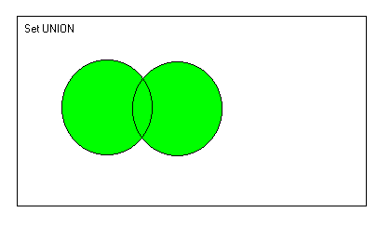
Graphic – Venn

Slide 7
Note on Unions
Must be union compatible.
Not quite sure what Patrick has in mind with his statements on pgs. 392-394.

Slide 8
Intersection
Only the members that are common to each set are included in the output set.

Slide 9
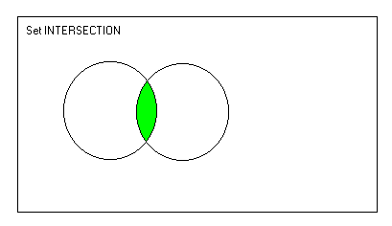
Graphic - Venn

Slide 10
Difference
Only the members of the first set, that are not shared with the second set, are included in the output.

Slide 11
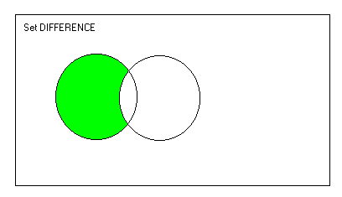
Graphic - Venn

Slide 12
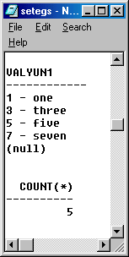
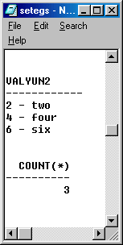
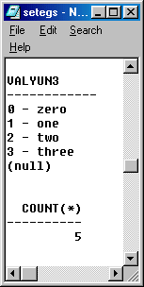
Sample Tables

Slide 13
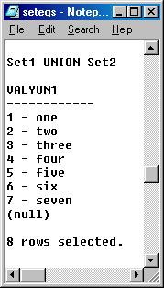
UNION Example

Slide 14
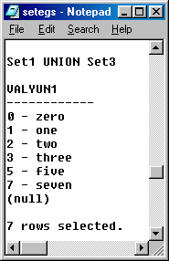

Slide 15
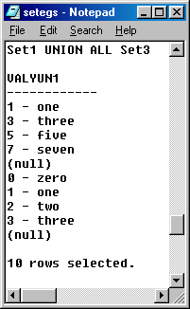

Slide 16
INTERSECT Example

Slide 17
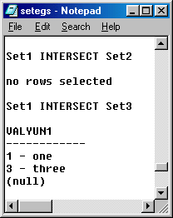

Slide 18
MINUS Example

Slide 19
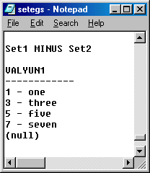

Slide 20
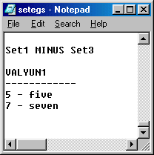

Slide 21
Relation Theoretic
Rename
Project
Select
(Cartesian) Product
Natural Join

Slide 22
Rename
This operation renames a relation.
Input: relation, output: relation

Slide 23
Project
Specifies attributes for inclusion in the output relation.
Vertical subset Column subset

Slide 24
Select
Specifies which tuples are to be included in the output relation.
Horizontal subset Row subset

Slide 25
Product
Cross product Cartesian product cross join

Slide 26
Natural Join
Cross product with the duplicate column removed.

Slide 27
Core Set of Operations
Rename
Select
Project
Cartesian product
Union
Difference

Slide 28
Derived set of operations
Intersection
Natural Join

Slide 29
Intersection
A – (A – B)
Graph: A - B
Graph A – (A – B)

Slide 30
Natural Join
Eliminate the duplicate column via projection.

Slide 31
Comments / Questions

